Slide 1
FERTILIZATION TO IMPLANTATION
Dr. Mbira

Slide 2
An ovulated ovum must be fertilized within 24 hrs.
Once the male and female pronucleus unite, fertilization is said to have occurred with the intermingling of paternal and maternal chromosomes and formation of a 2 cell conceptus called a zygote.
The zygote will then undergo a series of changes and at the same time be travelling along the fallopian tube to the uterine cavity.
At the end of 1 week post-fertilization, it will be implanted in the wall of the uterus.

Slide 3
The 2 cell zygote is still covered by the zona pellucida and it will now begin to undergo a series of rapid mitotic divisions of the cells to form 4, then 8 then 16 and so on.
As the cells in the zygote are dividing, they will become more compact in that limited space enclosed by the tough zona pellucida. This is known as compaction. The cells are now smaller and tightly packed together and are called blastomeres.
At the 16 cell stage, the zygote will have very tightly compacted cells and will now be called a morula. The cells approximating the zona pellucida will form the outer cell mass while those compacted inside will be called the inner cell mass.
In the future, the outer cell mass will form the placenta while the inner cell mass will form the embryo.
All this will happen by the 3rd day post fertilization.

Slide 4
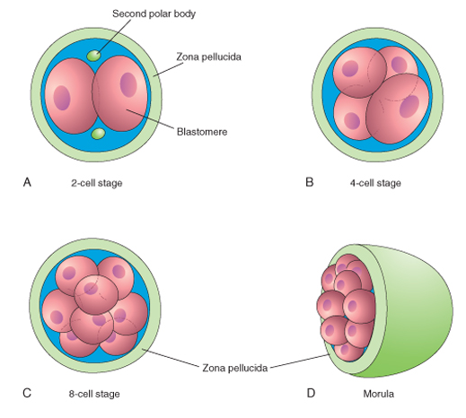
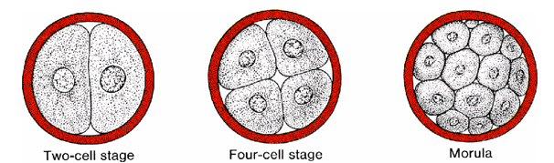

Slide 5
The morula then reaches the uterine cavity where it will swim about deriving nourishment from the fluid as well as secretions from glands in the uterus. This floating/swimming about takes 2 days then on the 6th day it will begin the process of implanting into the wall of the uterus.
Some of the fluid from the uterine cavity penetrates the zona pellucida through the outer cell mass and into the inner cell mass where it collects in a cavity called a blastocele. This makes the morula to now be called a blastocyst.
The blastocele will push the cells of the inner cell mass to one end of the blastocyst and they will now be called embryoblast. The outer cell mass will be flattened on the outer rim of the blastocyst and will be called trophoblast.
At this point, the zona pellucida will begin to degenerate and once the blastocyst has completely shed off/”hatched from” the zona pellucida, it is now free to rapidly increase in size and is now ready to implant.

Slide 6
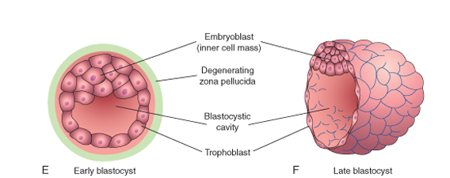

Slide 7
There are signalling molecules on the trophoblast cells which are attracted to the uterine wall where once they come into contact will begin the process of implantation.
The end of the blastocyst containing the embryoblast will come into contact with the uterine wall and subsequently from day 6, the trophoblast cells overlying the embryoblast will begin to penetrate the epithelial cells of the uterine mucosa.
At the same time, epithelial cells of the uterine mucosa will also begin to interact with the trophoblast cells to optimize this implantation and as such, implantantion is a 2-way affair.

Slide 8
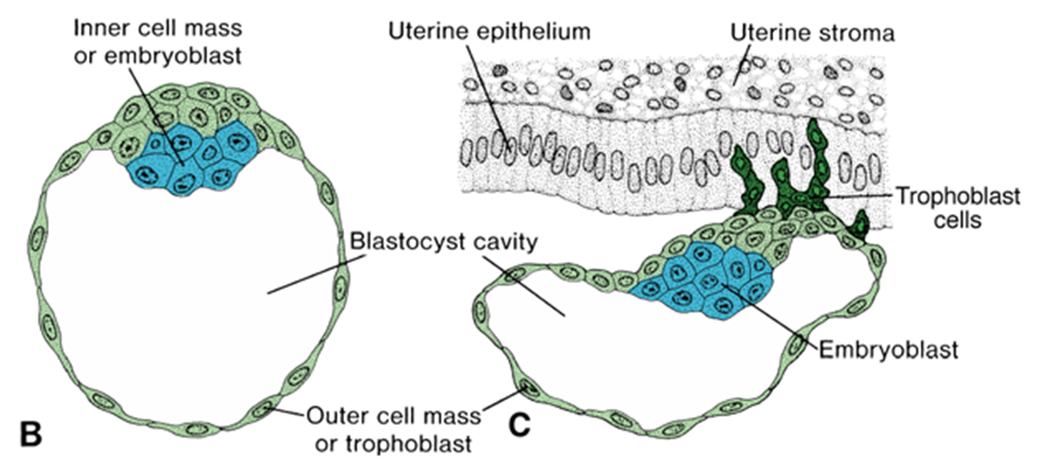

Slide 9
The uterine wall is in 3 layers:
Innermost mucosal epithelial layer – endometrium.
Middle, thick and muscular layer – myometrium.
Outer thin covering layer – perimetrium.
The endometrium in the reproductive years (from puberty to menopause) undergoes cyclic (usually monthly) proliferation then subsequent shedding as menstruation unless fertilization occurs where it continues in a proliferated, thickened state maintained so by progesterone hormone produced by the corpus luteum of pregnancy and later by the placenta.
The endometrium then has 2 stages:
Proliferative stage
Secretory stage – from ovulation onwards.

Slide 10
In the secretory stage/progestational stage, the endometrium is not only thickened but also has many arteries and glands.
It has 3 layers in this stage; superficial compact layer, spongy intermediate layer and a thin basal layer.
The thin basal layer is the one which remains after menstruation and is capable of regenerating the other 2 again under hormonal influence.

Slide 11
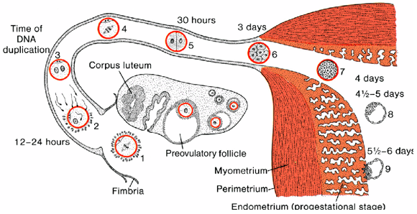
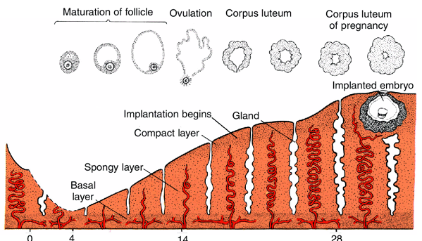

Slide 12
At the beginning of implantation, the trophoblast will proliferate and then differentiate into 2 layers: inner cytotrophoblast and outer syncytiotrophoblast under the influence of signalling proteins and carbohydrate molecules produced by the blastocyst as well as the uterine mucosa.
The syncytiotrophoblast will develop finger-like processes which penetrate the endometrium.
The blastocyst will be implanted between the openings of the uterine glands.
Trophoblast cells produce enzymes which erode the uterine epithelium making it easy for the blastocyst to burrow into the endometrium.

Slide 13
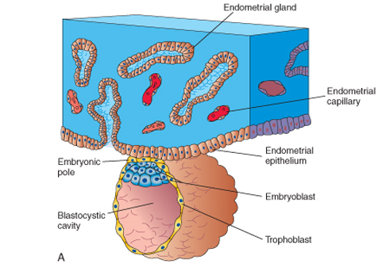
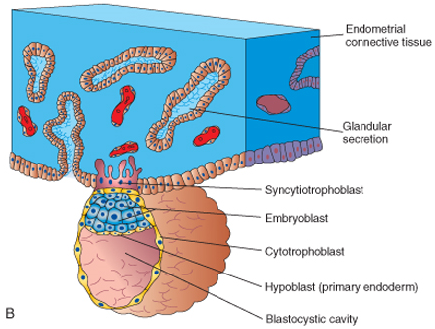

Slide 14
By the end of the first week the blastocyst will be embedded in the endometrial layer of the uterus with the syncytial layer of the trophoblast a.k.a syncytiotrophoblast burrowing its way into the endometrium.
Also, the cells of the syncytiotrophoblast will lose their cell membranes and become confluent i.e lacking clear cell boundaries as the endometrial cells around the area of invasion by the blastocyst undergo apoptosis to provide space.
Also there will be accumulation of lipids and glycogen by the endometrial cells .
These degenerating endometrial cells will be engulfed by the syncytiotrophoblast and provide nutrition for the early embryo.

Slide 15
*Early pregnancy loss
*Infertility in men and women
*Multiple gestation

